Slide 1

Testing
Unit Tests, Mocking, Integration Tests, Selenium
SoftUni Team
Technical Trainers
Software University
http://softuni.bg

Slide 2
Table of Contents
Testing
Unit Testing
Mocking
Integration Testing
Selenium
Selenium Integration
MyTested.AspNetCore.Mvc

Slide 3
Have a Question?
sli.do #csharp-web

Slide 4

Testing
Attention Please!

Slide 5

Testing
Testing is an important part of the application lifecycle
In our ever-changing environment, testing is a necessity
New features need to be verified, before delivered to the clients
Testing is a wide area of application development
There are several levels of testing
It does not affect only programmers
It has many concepts of development
There are different types of testing

Slide 6

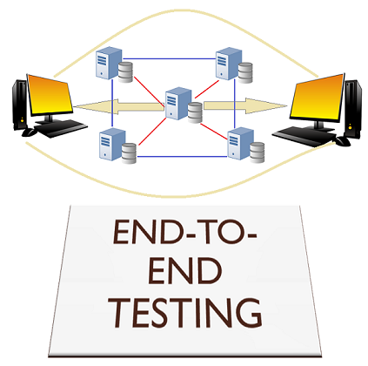

Testing
Web applications also need testing for "unintentional features"
Controllers, Services, Custom Components etc.
Different components of the application are tested differently
They are tested on different levels
Unit testing
Integration testing
End-to-End testing
Every component of the application must be tested

Slide 7
Testing
Some of the most common levels of Software Testing
Testing Level | Description
Unit Testing | Tests individiual parts of the code, independent from the infrastructure
Component Testing | Testing of multiple functionalities (a single component)
Integration Testing | Testing of all integrated modules to verify the combined functionality
System Testing | Tests the system as a whole, once all the components are integrated
Regression Testing | Ensures that a fixed bug won't happen again
Acceptance Testing | Tests if the product meets the client’s requirements. Purely done by QAs
Load / Stress Testing | Test the application’s limits by attempting large data processing (Apache JMeter)and introducting abnormal circumstances and conditions (edge cases)
Security Testing | Test if the application has any security flaws and vulnerabilities
Other Types of Testing | Manual, automation, UI, performance, black box, end-to-end testing, A/B, etc.

Slide 8
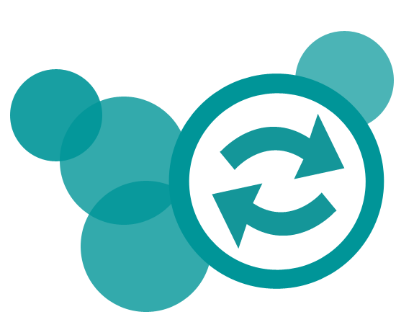
Testing
There are also different concepts and practices of test development
Code-first approach (The usual Development)
Test-first approach (Test-Driven Development)
Each has its own advantages and disadvantages
The Code-first approach ensures flexibility & fast development
The Code-first approach tends to create tests based on the code
The Test-first approach ensures quality and edge case coverage
The Test-first approach is complicated and is an "initial delay"

Slide 9

Unit Testing

Slide 10
Unit Testing
Unit Testing web apps is pretty much like casual unit testing
Writing test methods to test classes and methods (functionalities)
Testing individual code components (units)
Independently from the infrastructure
You still use the same testing frameworks as in casual unit testing
When using a web frameworks such as ASP.NET Core
Built-in logic does not need to be tested
It is already tested during the development of the framework itself
You still need to test your custom functionality

Slide 11

xUnit
xUnit is a free, open source, community-focused unit testing tool for the .NET Framework, UWP, Xamarin and .NET Core
To use it just follow these steps:
Create a new class library
Change the TargetFramework to be netcoreapp2.2
Install the following NuGet packages:
Microsoft.NET.Test.Sdk
xunit
xunit.runner.visualstudio
Create a class and add public method with [Fact] attribute
To run tests use Visual Studio or console with dotnet test

Slide 12
Mocking
Mocking – something made as an imitation
Mocking is a software practice, primarily used in Unit Testing
An object under test may have dependencies on other objects
To isolate the behavior, the other objects are replaced
The replacements are mocked objects
The mocked objects simulate the behavior of the real objects
Useful if the real objects are impractical/incorporate to the unit test
Basically, Mocking is creating objects that simulate behavior
In .NET we can use the Moq library to create mock objects

Slide 13


Mocking
Testing a simple service with mocking in an ASP.NET Core app
public class UserProfile
{
public string Username { get; set; }
public string Password { get; set; }
}
public interface IUserService
{
UserProfile FindUserByUsername(string username);
}
public class UserService : IUserService
{
private readonly IUserRepository userRepository;
public UserService(IUserRepository userRepository)
{
this.userRepository = userRepository;
}
public UserProfile FindUserByUsername(string username)
=> this.userRepository
.GetAllUsers()
.SingleOrDefault(u => u.Username == username);
}
public interface IUserRepository
{
IEnumerable<UserProfile> GetAllUsers();
}

Slide 14
Mocking
Testing a simple service with mocking in an ASP.NET Core app
NOTE: You will need the following NuGet package installed: Moq
public class UserServiceTests
{
public List<UserProfile> GetTestData()
{
return new List<UserProfile>
{
new UserProfile { Username = "Pesho",
Password = "123" },
new UserProfile {
Username = "Ivo",
Password = "Pivo"
}
};
}
... }
public class UserServiceTests
{
...
[Fact]
public void Method_ReturnsCorrect_WhenCorrectIsGiven()
{
var repo = new Mock<IUserRepository>();
repo.Setup(r => r.GetAllUsers())
.Returns(GetTestData());
IUserService service = new UserService(repo.Object);
UserProfile user = service.FindUserByUsername("Pesho");
Assert.True(user.Username == "Pesho", "Broken...");
Assert.True(user.Password == "123", "Broken...");
}
}

Slide 15
In-memory Database
Services, accessing a Database, can (and should) also be tested
When testing such Services, you don't create a new Database
This would, otherwise, overload the Database Server
When testing such Service, you use In-Memory Database
EF Core provides an In-Memory Database
Included with the Microsoft.EntityFrameworkCore.InMemory package
The In-Memory is non-relational, and it doesn’t have to be
The In-Memory database’s general purpose is to be a testing database

Slide 16

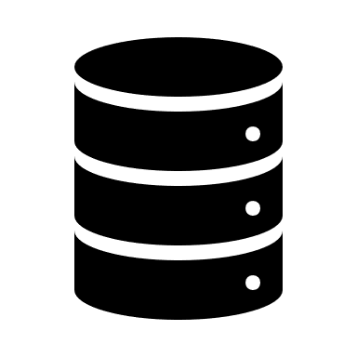


In-memory Database
Using EF Core's In-Memory Database in Unit Tests
public class UserProfile
{
public string Id { get; set; }
public string Username { get; set; }
public string Password { get; set; }
}
public class AppDbContext : DbContext
{
public AppDbContext(DbContextOptions<AppDbContext> options) : base(options) { }
public DbSet<UserProfile> UserProfiles { get; set; }
}
public class UserService : IUserService
{
private readonly AppDbContext appDbContext;
public UserService(AppDbContext appDbContext)
{
this.appDbContext = appDbContext;
}
public UserProfile FindUserByUsername(string username)
=> this.appDbContext.UserProfiles.SingleOrDefault(u => u.Username == username);
}

Slide 17
In-memory Database
Using EF Core's In-Memory Database in Unit Tests
public class UserServiceTests
{
...
[Fact]
public void Method_ReturnsCorrect_WhenCorrectIsGiven()
{
var options = new DbContextOptionsBuilder<AppDbContext>()
.UseInMemoryDatabase(databaseName: "Find_User_Database") // Give a Unique name to the DB
.Options;
using (var dbContext = new AppDbContext(options)) // Initialize Testing Data
{
dbContext.UserProfiles.AddRange(GetTestData());
dbContext.SaveChanges();
}
UserProfile user = null;
...
}
}

Slide 18
In-memory Database
Using EF Core's In-Memory Database in Unit Tests
public class UserServiceTests
{
...
[Fact]
public void Method_ReturnsCorrect_WhenCorrectIsGiven()
{
...
using (var dbContext = new AppDbContext(options)) // Initialize Context again
{
IUserService service = new UserService(dbContext); // Pass it to Service as dependency
user = service.FindUserByUsername("Pesho"); // Find the User
}
Assert.True(user != null, "Broken..."); // Check if the User is null (we set it to null initially)
Assert.True(user.Username == "Pesho", "Broken...");
Assert.True(user.Password == "123", "Broken...");
}
}

Slide 19
Integration Testing

Slide 20
Integration Testing
Integration Testing ensures app components:
Function correctly at the level of the infrastructure
Database, File System, Network, Pipelines etc.
Work together correctly to produce expected results
Integration Tests are far more complicated than Unit Tests
Use actual components, rather than mocked such
Require more code and data processing
Take longer time develop, run and process

Slide 21
Integration Testing
ASP.NET Core supports Integration Testing using a Unit Test framework
The framework has an integrated web host and in-memory test server
Integration Tests follow a sequence of events
The app's web host must be configured
A test server client is created to submit requests to the app
[Arrange] The test app prepares a request
[Act] The client submits the request and receives a response
[Assert] The actual response is validated based on expected result
After all tests have run, the results are reported

Slide 22
Integration Testing
public class IntegrationTest : IClassFixture<WebApplicationFactory<Startup>>
{
private readonly WebApplicationFactory<Startup> factory;
public IntegrationTest(WebApplicationFactory<Startup> factory)
{
this.factory = factory;
}
...
}
IClassFixture interface indicates the class contains tests and provides shared object instances across tests in the class
TEntryPoint is the entry point of the Tested App. Usually that is the Startup.cs
WebApplicationFactory<TEntryPoint> is used to create a TestServer
public class IntegrationTest : IClassFixture<WebApplicationFactory<Startup>>
{
...
[Theory]
[InlineData("/")]
[InlineData("/About")]
[InlineData("/Contacts")]
public async Task Test_EndpointReturnSuccessAndCorrectContentType(string url) { ... }
}
Used to parameterize a test
NOTE: You will need the following NuGet package installed
Microsoft.AspNetCore.Mvc.Testing
Used to pass parameters to the test

Slide 23
Integration Testing
This integration test, simply tests response status code and content type
public class IntegrationTest : IClassFixture<WebApplicationFactory<Startup>>
{
...
[Theory]
[InlineData("/")]
[InlineData("/About")]
[InlineData("/Contacts")]
public async Task Test_EndpointReturnSuccessAndCorrectContentType(string url)
{
//Arrange
var client = this.factory.CreateClient(); // Creates a HttpClient
//Act
var response = await client.GetAsync(url); // Simulates a Get Request to the given URL
//Assert
response.EnsureSuccessStatusCode(); // 200 - 299 (SUCCESS)
Assert.Equal("text/html; charset=utf-8", response.Content.Headers.ContentType.ToString());
}
}
NOTE: You will need the following NuGet package installed
Microsoft.AspNetCore.App
Also you need Sdk="Microsoft.NET.Sdk.Web"

Slide 24

Selenium

Slide 25


Selenium
Selenium is a portable testing framework for web applications
Provides a playback tool for authoring tests (Selenium IDE)
Provides a test domain-specific language (Selenese)
Provides "browser driving" natively (Selenium WebDriver)
"Selenium automates browsers. That’s it!" Selenium docs
Automates web applications for test purposes
Useful for integration testing SPA apps

Slide 26
Install and Set-up Selenium
Install latest stable Node.js: https://nodejs.org/en/
Install the npm package:
Install latest Java: https://www.java.com/en/download/
Download Selenium Standalone Server JAR
https://www.seleniumhq.org/download/
Download ChromeDriver (to match your Chrome version)
http://chromedriver.chromium.org/downloads
Extract the file in the same folder as Selenium Standalone Server
Start selenium server
npm install –g selenium-standalone
java -jar .\selenium-server-standalone-3.141.59.jar

Slide 27
Selenium
Let‚ s see how Selenium is used in ASP.NET Core App Testing
NuGet packages: Selenium.Support and Selenium.WebDriver
public class SeleniumServerFactory<TStartup>
: WebApplicationFactory<Startup> where TStartup : class
{
private readonly Process process;
private IWebHost host;
public SeleniumServerFactory() { ... }
public string RootUri { get; set; } //Save this use by tests
protected override TestServer CreateServer(IWebHostBuilder builder) { ... }
protected override void Dispose(bool disposing) { ... }
public class FakeStartup { ... }
}

Slide 28
Selenium
Let's see how Selenium is used in ASP.NET Core App Testing
public class SeleniumServerFactory<TStartup>
: WebApplicationFactory<Startup> where TStartup : class
{
...
public SeleniumServerFactory()
{
ClientOptions.BaseAddress = new Uri("https://localhost");
this.process = new Process() {
StartInfo = new ProcessStartInfo {
FileName = "selenium-standalone",
Arguments = "start",
UseShellExecute = true
}
};
this.process.Start();
}
...
}

Slide 29
Selenium
Let's see how Selenium is used in ASP.NET Core App Testing
public class SeleniumServerFactory<TStartup>
: WebApplicationFactory<Startup> where TStartup : class
{
...
protected override TestServer CreateServer(IWebHostBuilder builder)
{
// Real TCP port
this.host = builder.Build();
this.host.Start();
// Last is https://localhost:5001!
this.RootUri = this.host.ServerFeatures.Get<IServerAddressesFeature>().Addresses.LastOrDefault();
// Fake Server we won't use
return new TestServer(new WebHostBuilder().UseStartup<FakeStartup>());
}
...
}

Slide 30
Selenium
Let's see how Selenium is used in ASP.NET Core App Testing
We are just getting started, this is only the factory.
public class SeleniumServerFactory<TStartup>
: WebApplicationFactory<Startup> where TStartup : class
{
...
protected override void Dispose(bool disposing)
{
base.Dispose(disposing);
if (disposing) {
this.host.Dispose();
this.process.CloseMainWindow(); // Be sure to stop Selenium Standalone
}
}
}

Slide 31
Selenium
public class SeleniumTests : IClassFixture<SeleniumServerFactory<Startup>>
{
private readonly SeleniumServerFactory<Startup> server;
private readonly IWebDriver browser;
public SeleniumTests(SeleniumServerFactory<Startup> server)
{
this.server = server;
server.CreateClient(); // This call shouldn't be required for setup, but it is. (weird)
var opts = new ChromeOptions();
opts.AddArgument("--headless"); // Optional, comment this out if you want to SEE the browser window
opts.AddArgument("no-sandbox");
this.browser = new RemoteWebDriver(opts);
}
...
}

Slide 32


Selenium
And now that the configuration is done, let’s see some tests
public class SeleniumTests :
IClassFixture<SeleniumServerFactory<Startup>>
{
...
[Fact]
public void LoadTheMainPageAndCheckTitle()
{
browser.Navigate().GoToUrl(server.RootUri);
Assert.StartsWith("Sample", browser.Title);
}
...
}
public class SeleniumTests :
IClassFixture<SeleniumServerFactory<Startup>>
{
...
[Fact]
public void ThereIsAnH1()
{
browser.Navigate().GoToUrl(server.RootUri);
var headerSelector = By.TagName("h1");
Assert.Equal("Heading", browser.FindElement(headerSelector).Text);
}
...
}

Slide 33

MyTested.AspNetCore.Mvc

Slide 34

MyTested.AspNetCore.Mvc
MyTested.AspNetCore.Mvc is a powerful testing library
Automatic resolving of test dependencies
Fluent API with strongly-typed extensions (no magic strings & HTML)
Unit tests, integration tests, route tests, everything covered
Built-in mocks for every ASP.NET Core scenario
Authentication
DbContext
HTTP
Session
Caching
And many more…

Slide 35
MyTested.AspNetCore.Mvc
MyController<MyMvcController>
.Instance()
.WithUser(user => user.WithUsername("MyUserName"))
.WithData(MyDataProvider.GetMyModels()
.Calling(c => c.MyAction(myRequestModel))
.ShouldHave()
.ValidModelState()
.AndAlso()
.ShouldHave()
.ViewBag(viewBag => viewBag
.ContainingEntry("MyViewBagProperty", "MyViewBagValue"))
.AndAlso()
.ShouldReturn()
.View(result => result
.WithModelOfType<MyResponseModel>()
.Passing(model =>
{
Assert.AreEqual(1, model.Id);
Assert.AreEqual("My property value", model.MyProperty);
}));

Slide 36
MyTested.AspNetCore.Mvc
Check out the repository README to get started:
https://github.com/ivaylokenov/MyTested.AspNetCore.Mvc
And take a look at this Blog sample for more details:
https://github.com/ivaylokenov/MyTested.AspNetCore.Mvc/tree/development/samples/Blog
Available versions:
2.2.0 – for .NET Core 2
1.1.0 – for .NET Core 1.1
1.0.0 – for .NET Core 1.0
Install-Package MyTested.AspNetCore.Mvc.Universe -Version 2.2.0
dotnet add package MyTested.AspNetCore.Mvc.Universe --version 2.2.0

Slide 37

Summary
Testing
Unit Testing
Mocking
Integration Testing
Selenium
Selenium Integration
MyTested.AspNetCore.Mvc
…
…
…

Slide 38
https://softuni.bg/trainings/courses

Slide 39










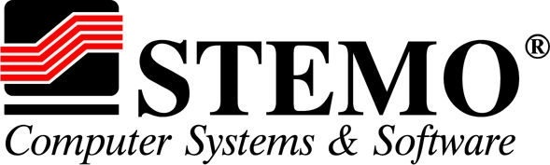

SoftUni Diamond Partners

Slide 40




SoftUni Organizational Partners

Slide 41




Trainings @ Software University (SoftUni)
Software University – High-Quality Education and Employment Opportunities
softuni.bg
Software University Foundation
http://softuni.foundation/
Software University @ Facebook
facebook.com/SoftwareUniversity
Software University Forums
forum.softuni.bg

Slide 42

License
This course (slides, examples, demos, videos, homework, etc.) is licensed under the "Creative Commons Attribution-NonCommercial-ShareAlike 4.0 International" license

